Slide 1
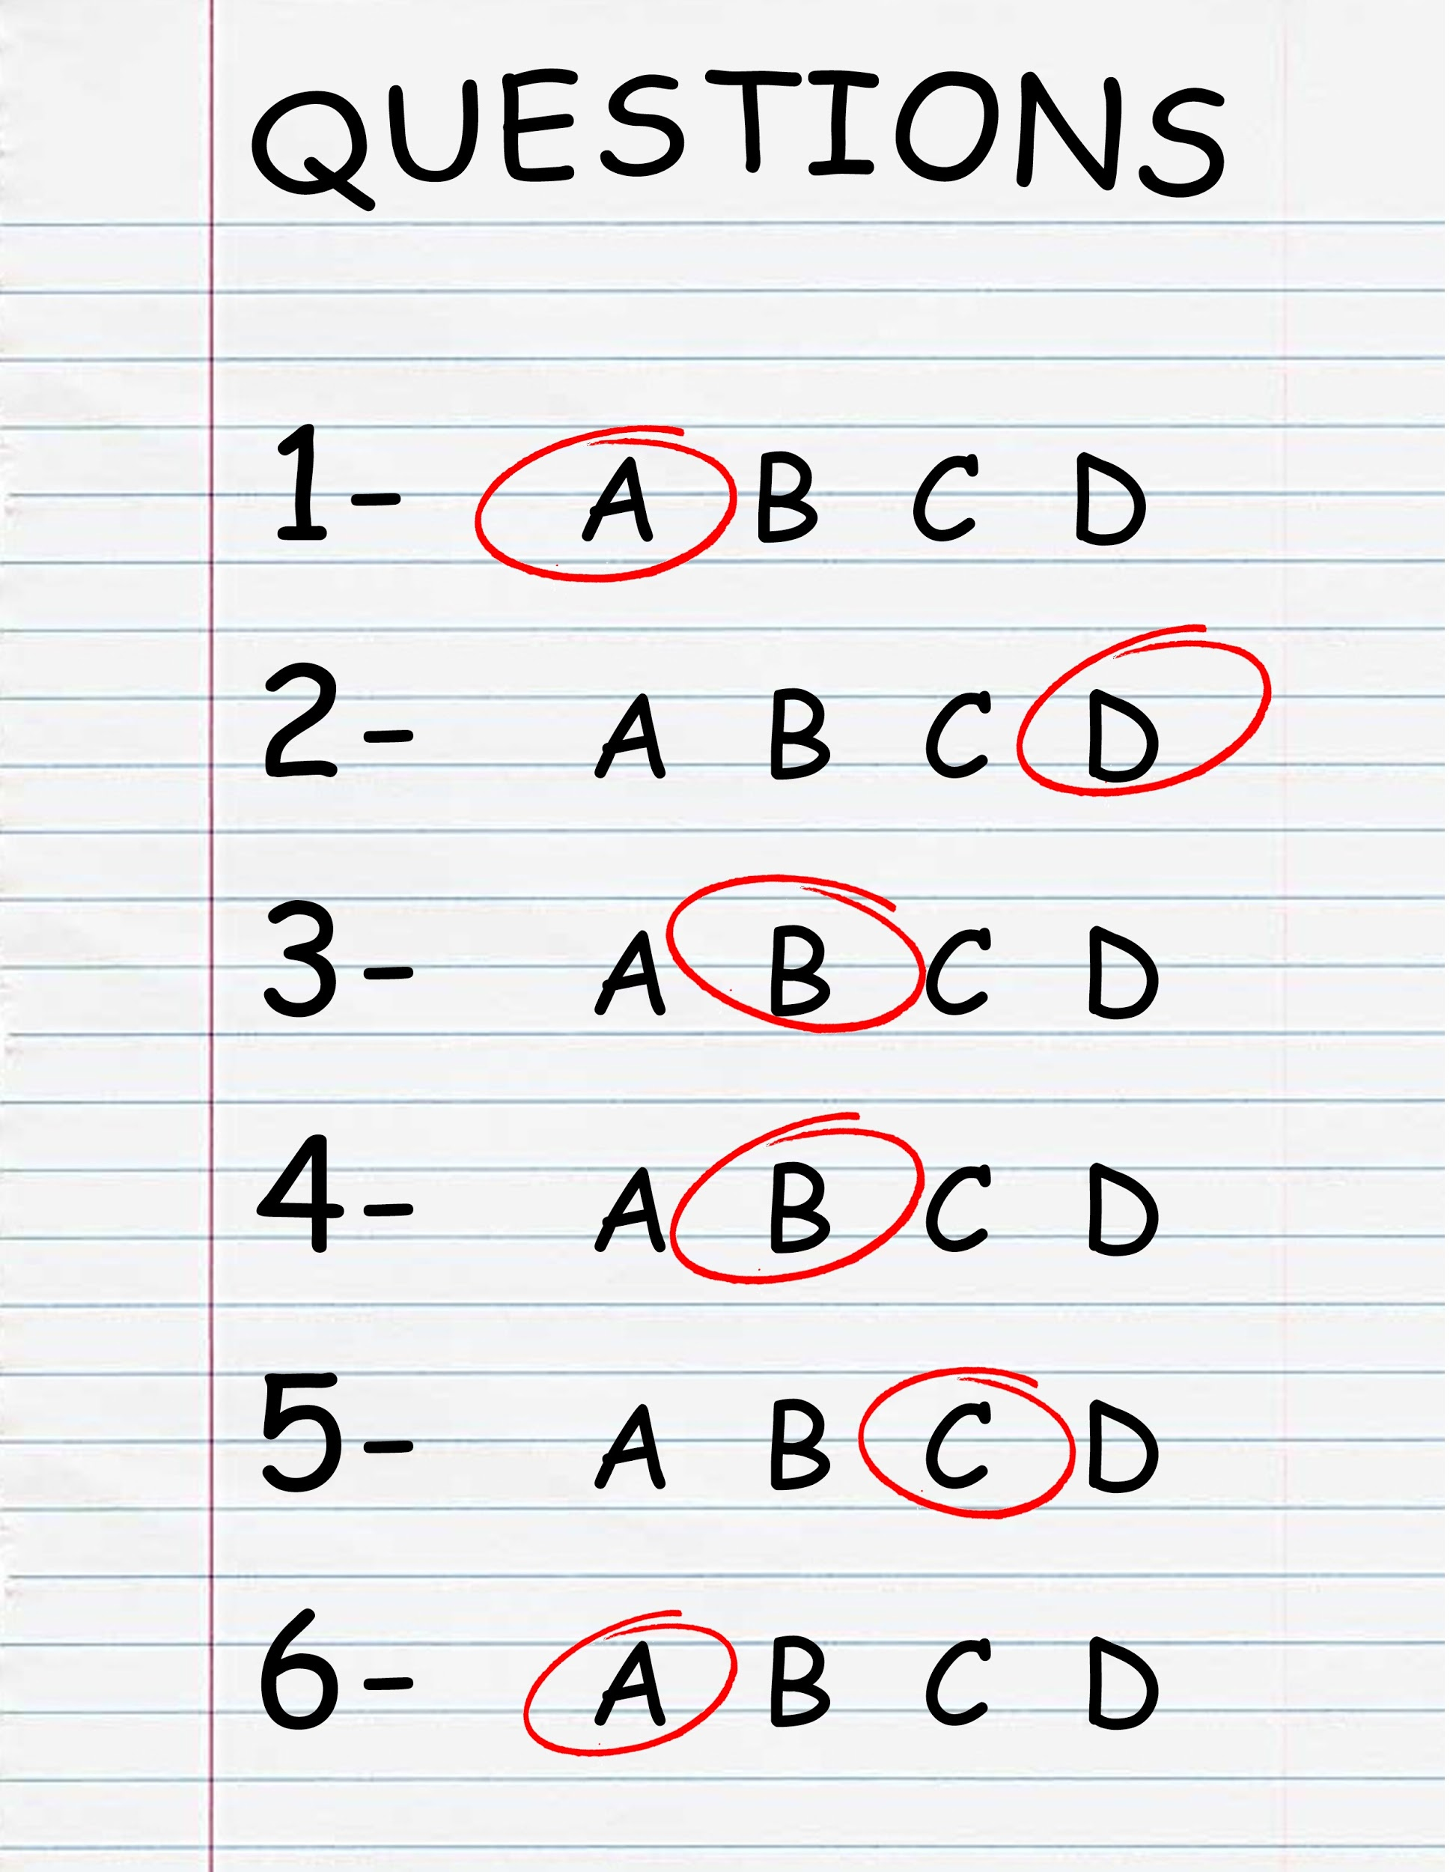
Welcome to CS149 Students to….
THE FOURTH HOUR
TOPIC - Midterm 2 Exam Review
Notes:
While students are filtering in, circulate a piece of paper for students to write their names on. Include a place for name and professor. If a student came in late, note what time they came in so that we can accurately track data. (The observing TA should probably be the one to manage and record when a student comes in late)

Slide 2

Introductions
Name
Professor
Fun Fact About yourself

Slide 3
Recursion Review
public static void main(String[] args) {
System.out.println(" " + divideByThree(9));
}
public static int divideByThree(int num) {
if(num <= 0){
return num;
} else {
return divideByThree(num - 3) + 1;
}
}
main

Slide 4
Recursion Review
public static void main(String[] args) {
System.out.println(" " + divideByThree(9));
}
public static int divideByThree(int num) {
if(num <= 0){
return num;
} else {
return divideByThree(num - 3) + 1;
}
}
print(?)
main

Slide 5
Recursion Review
public static void main(String[] args) {
System.out.println(" " + divideByThree(9));
}
public static int divideByThree(int num) {
if(num <= 0){
return num;
} else {
return divideByThree(num - 3) + 1;
}
}
print(?)
main
divideByThree
num

Slide 6
Recursion Review
public static void main(String[] args) {
System.out.println(" " + divideByThree(9));
}
public static int divideByThree(int num) {
if(num <= 0){
return num;
} else {
return divideByThree(num - 3) + 1;
}
}
print(?)
main
divideByThree
num
9

Slide 7
Recursion Review
public static void main(String[] args) {
System.out.println(" " + divideByThree(9));
}
public static int divideByThree(int num) {
if(num <= 0){
return num;
} else {
return divideByThree(num - 3) + 1;
}
}
print(?)
main
divideByThree
num
9

Slide 8
Recursion Review
public static void main(String[] args) {
System.out.println(" " + divideByThree(9));
}
public static int divideByThree(int num) {
if(num <= 0){
return num;
} else {
return divideByThree(num - 3) + 1;
}
}
print(?)
main
divideByThree
num
9
Return - return divideByThree(num - 3) + 1;

Slide 9
Recursion Review
public static void main(String[] args) {
System.out.println(" " + divideByThree(9));
}
public static int divideByThree(int num) {
if(num <= 0){
return num;
} else {
return divideByThree(num - 3) + 1;
}
}
print(?)
main
divideByThree
num
9
Return - return divideByThree(num - 3) + 1;
divideByThree
num
9-3

Slide 10
Recursion Review
public static void main(String[] args) {
System.out.println(" " + divideByThree(9));
}
public static int divideByThree(int num) {
if(num <= 0){
return num;
} else {
return divideByThree(num - 3) + 1;
}
}
print(?)
main
divideByThree
num
9
Return - return divideByThree(num - 3) + 1;
divideByThree
num
6

Slide 11
Recursion Review
public static void main(String[] args) {
System.out.println(" " + divideByThree(9));
}
public static int divideByThree(int num) {
if(num <= 0){
return num;
} else {
return divideByThree(num - 3) + 1;
}
}
print(?)
main
divideByThree
num
9
Return - return divideByThree(num - 3) + 1;
divideByThree
num
6

Slide 12
Recursion Review
public static void main(String[] args) {
System.out.println(" " + divideByThree(9));
}
public static int divideByThree(int num) {
if(num <= 0){
return num;
} else {
return divideByThree(num - 3) + 1;
}
}
print(?)
main
divideByThree
num
9
Return - return divideByThree(num - 3) + 1;
divideByThree
num
6

Slide 13
Recursion Review
public static void main(String[] args) {
System.out.println(" " + divideByThree(9));
}
public static int divideByThree(int num) {
if(num <= 0){
return num;
} else {
return divideByThree(num - 3) + 1;
}
}
print(?)
main
divideByThree
num
9
Return - return divideByThree(num - 3) + 1;
divideByThree
num
6
Return - return divideByThree(num - 3) + 1;

Slide 14
Recursion Review
public static void main(String[] args) {
System.out.println(" " + divideByThree(9));
}
public static int divideByThree(int num) {
if(num <= 0){
return num;
} else {
return divideByThree(num - 3) + 1;
}
}
print(?)
main
divideByThree
num
9
Return - return divideByThree(num - 3) + 1;
divideByThree
num
6
Return - return divideByThree(num - 3) + 1;
divideByThree
num
6 - 3

Slide 15
Recursion Review
public static void main(String[] args) {
System.out.println(" " + divideByThree(9));
}
public static int divideByThree(int num) {
if(num <= 0){
return num;
} else {
return divideByThree(num - 3) + 1;
}
}
print(?)
main
divideByThree
num
9
Return - return divideByThree(num - 3) + 1;
divideByThree
num
6
Return - return divideByThree(num - 3) + 1;
divideByThree
num
3

Slide 16
Recursion Review
public static void main(String[] args) {
System.out.println(" " + divideByThree(9));
}
public static int divideByThree(int num) {
if(num <= 0){
return num;
} else {
return divideByThree(num - 3) + 1;
}
}
print(?)
main
divideByThree
num
9
Return - return divideByThree(num - 3) + 1;
divideByThree
num
6
Return - return divideByThree(num - 3) + 1;
divideByThree
num
3

Slide 17
Recursion Review
public static void main(String[] args) {
System.out.println(" " + divideByThree(9));
}
public static int divideByThree(int num) {
if(num <= 0){
return num;
} else {
return divideByThree(num - 3) + 1;
}
}
print(?)
main
divideByThree
num
9
Return - return divideByThree(num - 3) + 1;
divideByThree
num
6
Return - return divideByThree(num - 3) + 1;
divideByThree
num
3

Slide 18
Recursion Review
public static void main(String[] args) {
System.out.println(" " + divideByThree(9));
}
public static int divideByThree(int num) {
if(num <= 0){
return num;
} else {
return divideByThree(num - 3) + 1;
}
}
print(?)
main
divideByThree
num
9
Return - return divideByThree(num - 3) + 1;
divideByThree
num
6
Return - return divideByThree(num - 3) + 1;
divideByThree
num
3
Return - return divideByThree(num - 3) + 1;

Slide 19
Recursion Review
public static void main(String[] args) {
System.out.println(" " + divideByThree(9));
}
public static int divideByThree(int num) {
if(num <= 0){
return num;
} else {
return divideByThree(num - 3) + 1;
}
}
print(?)
main
divideByThree
num
9
Return - return divideByThree(num - 3) + 1;
divideByThree
num
6
Return - return divideByThree(num - 3) + 1;
divideByThree
num
3
Return - return divideByThree(num - 3) + 1;
divideByThree
num
3 - 3

Slide 20
Recursion Review
public static void main(String[] args) {
System.out.println(" " + divideByThree(9));
}
public static int divideByThree(int num) {
if(num <= 0){
return num;
} else {
return divideByThree(num - 3) + 1;
}
}
print(?)
main
divideByThree
num
9
Return - return divideByThree(num - 3) + 1;
divideByThree
num
6
Return - return divideByThree(num - 3) + 1;
divideByThree
num
3
Return - return divideByThree(num - 3) + 1;
divideByThree
num
0

Slide 21
Recursion Review
public static void main(String[] args) {
System.out.println(" " + divideByThree(9));
}
public static int divideByThree(int num) {
if(num <= 0){
return num;
} else {
return divideByThree(num - 3) + 1;
}
}
print(?)
main
divideByThree
num
9
Return - return divideByThree(num - 3) + 1;
divideByThree
num
6
Return - return divideByThree(num - 3) + 1;
divideByThree
num
3
Return - return divideByThree(num - 3) + 1;
divideByThree
num
0

Slide 22
Recursion Review
public static void main(String[] args) {
System.out.println(" " + divideByThree(9));
}
public static int divideByThree(int num) {
if(num <= 0){
return num;
} else {
return divideByThree(num - 3) + 1;
}
}
print(?)
main
divideByThree
num
9
Return - return divideByThree(num - 3) + 1;
divideByThree
num
6
Return - return divideByThree(num - 3) + 1;
divideByThree
num
3
Return - return divideByThree(num - 3) + 1;
divideByThree
num
0

Slide 23
Recursion Review
public static void main(String[] args) {
System.out.println(" " + divideByThree(9));
}
public static int divideByThree(int num) {
if(num <= 0){
return num;
} else {
return divideByThree(num - 3) + 1;
}
}
print(?)
main
divideByThree
num
9
Return - return divideByThree(num - 3) + 1;
divideByThree
num
6
Return - return divideByThree(num - 3) + 1;
divideByThree
num
3
Return - return divideByThree(num - 3) + 1;
divideByThree
num
0
Return - return num

Slide 24
Recursion Review
public static void main(String[] args) {
System.out.println(" " + divideByThree(9));
}
public static int divideByThree(int num) {
if(num <= 0){
return num;
} else {
return divideByThree(num - 3) + 1;
}
}
print(?)
main
divideByThree
num
9
Return - return divideByThree(num - 3) + 1;
divideByThree
num
6
Return - return divideByThree(num - 3) + 1;
divideByThree
num
3
Return - return divideByThree(num - 3) + 1;
divideByThree
num
0
Return - return 0

Slide 25
Recursion Review
public static void main(String[] args) {
System.out.println(" " + divideByThree(9));
}
public static int divideByThree(int num) {
if(num <= 0){
return num;
} else {
return divideByThree(num - 3) + 1;
}
}
print(?)
main
divideByThree
num
9
Return - return divideByThree(num - 3) + 1;
divideByThree
num
6
Return - return divideByThree(num - 3) + 1;
divideByThree
num
3
Return - return divideByThree(num - 3) + 1;
divideByThree
num
0
Return - 0

Slide 26
Recursion Review
public static void main(String[] args) {
System.out.println(" " + divideByThree(9));
}
public static int divideByThree(int num) {
if(num <= 0){
return num;
} else {
return divideByThree(num - 3) + 1;
}
}
print(?)
main
divideByThree
num
9
Return - return divideByThree(num - 3) + 1;
divideByThree
num
6
Return - return divideByThree(num - 3) + 1;
divideByThree
num
3
Return - return 0 + 1;
divideByThree
num
0
Return 0

Slide 27
Recursion Review
public static void main(String[] args) {
System.out.println(" " + divideByThree(9));
}
public static int divideByThree(int num) {
if(num <= 0){
return num;
} else {
return divideByThree(num - 3) + 1;
}
}
print(?)
main
divideByThree
num
9
Return - return divideByThree(num - 3) + 1;
divideByThree
num
6
Return - return divideByThree(num - 3) + 1;
divideByThree
num
3
Return 1
divideByThree
num
0
Return 0

Slide 28
Recursion Review
public static void main(String[] args) {
System.out.println(" " + divideByThree(9));
}
public static int divideByThree(int num) {
if(num <= 0){
return num;
} else {
return divideByThree(num - 3) + 1;
}
}
print(?)
main
divideByThree
num
9
Return - return divideByThree(num - 3) + 1;
divideByThree
num
6
Return - return 1 + 1;
divideByThree
num
3
Return 1
divideByThree
num
0
Return 0

Slide 29
Recursion Review
public static void main(String[] args) {
System.out.println(" " + divideByThree(9));
}
public static int divideByThree(int num) {
if(num <= 0){
return num;
} else {
return divideByThree(num - 3) + 1;
}
}
print(?)
main
divideByThree
num
9
Return - return divideByThree(num - 3) + 1;
divideByThree
num
6
Return 2
divideByThree
num
3
Return 1
divideByThree
num
0
Return 0

Slide 30
Recursion Review
public static void main(String[] args) {
System.out.println(" " + divideByThree(9));
}
public static int divideByThree(int num) {
if(num <= 0){
return num;
} else {
return divideByThree(num - 3) + 1;
}
}
print(?)
main
divideByThree
num
9
Return - return 2 + 1;
divideByThree
num
6
Return 2
divideByThree
num
3
Return 1
divideByThree
num
0
Return 0

Slide 31
Recursion Review
public static void main(String[] args) {
System.out.println(" " + divideByThree(9));
}
public static int divideByThree(int num) {
if(num <= 0){
return num;
} else {
return divideByThree(num - 3) + 1;
}
}
print(?)
main
divideByThree
num
9
Return 3
divideByThree
num
6
Return 2
divideByThree
num
3
Return 1
divideByThree
num
0
Return 0

Slide 32
Recursion Review
public static void main(String[] args) {
System.out.println(" " + divideByThree(9));
}
public static int divideByThree(int num) {
if(num <= 0){
return num;
} else {
return divideByThree(num - 3) + 1;
}
}
print(“ “ + 3)
main
divideByThree
num
9
Return 3
divideByThree
num
6
Return 2
divideByThree
num
3
Return 1
divideByThree
num
0
Return 0

Slide 33
Socrative Question 1
Go to https://b.socrative.com/login/student
Classroom name: FOURTHOUR

Slide 34
Socrative Question 1:
Given the following array what is printed?
int[] array = {3, 7, 4, 8, 11}
System.out.print(array[1] + “ “);
System.out.println(array[5]);
3 11
7 11
3 null
7 null
7 (Error message)

Slide 35
Socrative Question 1:
Given the following array what is printed?
int[] array = {3, 7, 4, 8, 11}
System.out.print(array[1] + “ “);
System.out.println(array[5]);
3 11
7 11
3 null
7 null
7 (Error message)

Slide 36
Array Indexing
Given the following array what is printed?
int[] array = {3, 7, 4, 8, 11}
System.out.print(array[1] + “ “);
System.out.println(array[5]);
3 | 7 | 4 | 8 | 11

Slide 37
Array Indexing
Given the following array what is printed?
int[] array = {3, 7, 4, 8, 11}
System.out.print(array[1] + “ “);
System.out.println(array[5]);
3 | 7 | 4 | 8 | 11
0 1 2 3 4

Slide 38
Array Indexing
Given the following array what is printed?
int[] array = {3, 7, 4, 8, 11}
System.out.print(array[1] + “ “);
System.out.println(array[5]);
3 | 7 | 4 | 8 | 11
0 1 2 3 4
7

Slide 39
Array Indexing
Given the following array what is printed?
int[] array = {3, 7, 4, 8, 11}
System.out.print(array[1] + “ “);
System.out.println(array[5]);
3 | 7 | 4 | 8 | 11
0 1 2 3 4
7
No index 5 so an error would be thrown and the message would show up in console

Slide 40
Activity
In groups of 2-3 rewrite the following code in a while loop:
public static void mystery(String sentence) {
String newSentence = "";
for (int i = 0; i < sentence.length() - 2; i+=4) {
newSentence += sentence.substring(i, i+2);
}
System.out.println(newSentence);
}

Slide 41
Solution
public static void mystery(String sentence) {
String newSentence = "";
int i = 0;
while (i < sentence.length() - 2) {
newSentence += sentence.substring(i, i+2);
i+=4;
}
System.out.println(newSentence);
}

Slide 42
What does the following code output?
public static void mystery(String sentence) {
String newSentence = "";
int i = 0;
while (i < sentence.length() - 2) {
newSentence += sentence.substring(i, i+2);
i+=4;
}
System.out.println(newSentence);
}
public static void main(String[] args) {
mystery("hiya there bestie");
String s = "hiya there bestie";
mystery(s);
}

Slide 43
What does the following code output?
public static void mystery(String sentence) {
String newSentence = "";
int i = 0;
while (i < sentence.length() - 2) {
newSentence += sentence.substring(i, i+2);
i+=4;
}
System.out.println(newSentence);
}
public static void main(String[] args) {
mystery("hiya there bestie");
String s = "hiya there bestie";
mystery(s);
}
hi trees
hi trees

Slide 44
Socrative Question 2
What is printed out by the following?
String[] words = {"I", "are", "there", "how", "are", "you"};
for (int i = words.length - 1; i >= 0; i-=2){
System.out.print(words[i] + " ");
}
I are there how are you
you how are
I there are
you how are I
you are how there are I

Slide 45
Socrative Question 2
What is printed out by the following?
String[] words = {"I", "are", "there", "how", "are", "you"};
for (int i = words.length - 1; i >= 0; i-=2){
System.out.print(words[i] + " ");
}
I are there how are you
you how are
I there are
you how are I
you are how there are I

Slide 46
Let’s go over it on the board using a stack diagram
String[] words = {"I", "are", "there", "how", "are", "you"};
for (int i = words.length - 1; i >= 0; i-=2){
System.out.print(words[i] + " ");
}

Slide 47
Socrative Question 3
What is the final value of sum?
int[] numbers = {2, 9, 3, 13, 18, 4, 7};
int sum = 0;
for (int num : numbers) { if (num % 2 == 0) { sum += num;
}
else if (num % 3 == 0) {
System.out.println(“number” + sum * 2);
}
}
24
56
28
30
22

Slide 48
Socrative Question 3
What is the final value of sum?
int[] numbers = {2, 9, 3, 13, 18, 4, 7};
int sum = 0;
for (int num : numbers) { if (num % 2 == 0) { sum += num;
}
else if (num % 3 == 0) {
System.out.println(“number” + sum * 2);
}
}
24
56
28
30
22

Slide 49
Activity
Write a function called findMax that takes in an integer array called arr. The method should return the largest number in arr. If the array is null the program should return -1. If the array is empty it should return -2.

Slide 50
public static int findMax(int[] arr) {
int max;
if (arr == null) {
max = -1;
} else if (arr.length == 0) {
max = -2;
} else {
max = arr[0];
for (int i = 1; i < arr.length; i++) {
if (arr[i] > max) {
max = arr[i];
}
}
return max;
}

Slide 51
public static int findMax(int[] arr) {
int max;
if (arr == null) {
max = -1;
} else if (arr.length == 0) {
max = -2;
} else {
max = arr[0];
for (int i = 1; i < arr.length; i++) {
if (arr[i] > max) {
max = arr[i];
}
}
return max;
}
How would I change this code to return the index where the max value is in the array?

Slide 52
public static int findMax(int[] arr) {
int max;
if (arr == null) {
max = -1;
} else if (arr.length == 0) {
max = -2;
} else {
max = arr[0];
for (int i = 1; i < arr.length; i++) {
if (arr[i] > max) {
max = arr[i];
}
}
return max;
}
How would I change this code to return the index where the max value is in the array?

Slide 53
public static int findMax(int[] arr) {
int max;
if (arr == null) {
max = -1;
} else if (arr.length == 0) {
max = -2;
} else {
max = 0;
for (int i = 1; i < arr.length; i++) {
if (arr[i] > max) {
max = arr[i];
}
}
return max;
}
How would I change this code to return the index where the max value is in the array?

Slide 54
public static int findMax(int[] arr) {
int max;
if (arr == null) {
max = -1;
} else if (arr.length == 0) {
max = -2;
} else {
max = 0;
for (int i = 1; i < arr.length; i++) {
if (arr[i] > max) {
max = arr[i];
}
}
return max;
}
How would I change this code to return the index where the max value is in the array?

Slide 55
public static int findMax(int[] arr) {
int max;
if (arr == null) {
max = -1;
} else if (arr.length == 0) {
max = -2;
} else {
max = 0;
for (int i = 1; i < arr.length; i++) {
if (arr[i] > max) {
max = i;
}
}
return max;
}
How would I change this code to return the index where the max value is in the array?

